Slide 1
School of MCB Undergraduate Research Information Session
Tina M. Knox,
Assistant Director for Advising and Recruitment
September 7, 2022

Slide 2
Agenda
Special information for biochemistry students
What is undergraduate research?
How to find a lab
How to enroll in MCB 290/BIOC 290
Faculty perspective
Student perspective
Graduation with Distinction, if time

Slide 3
Biochemistry Majors Only
BIOC 290, independent laboratory research
BIOC 492, senior thesis
Contact Jeff Goldberg for template email to use – not necessary to use student profile.
Forms signed by Jeff Goldberg, flexible deadlines
Need 6 hrs of senior research for distinction in biochem
Email Jeff for additional information, jmgoldbe@illinois.edu, Room 417 RAL

Slide 4
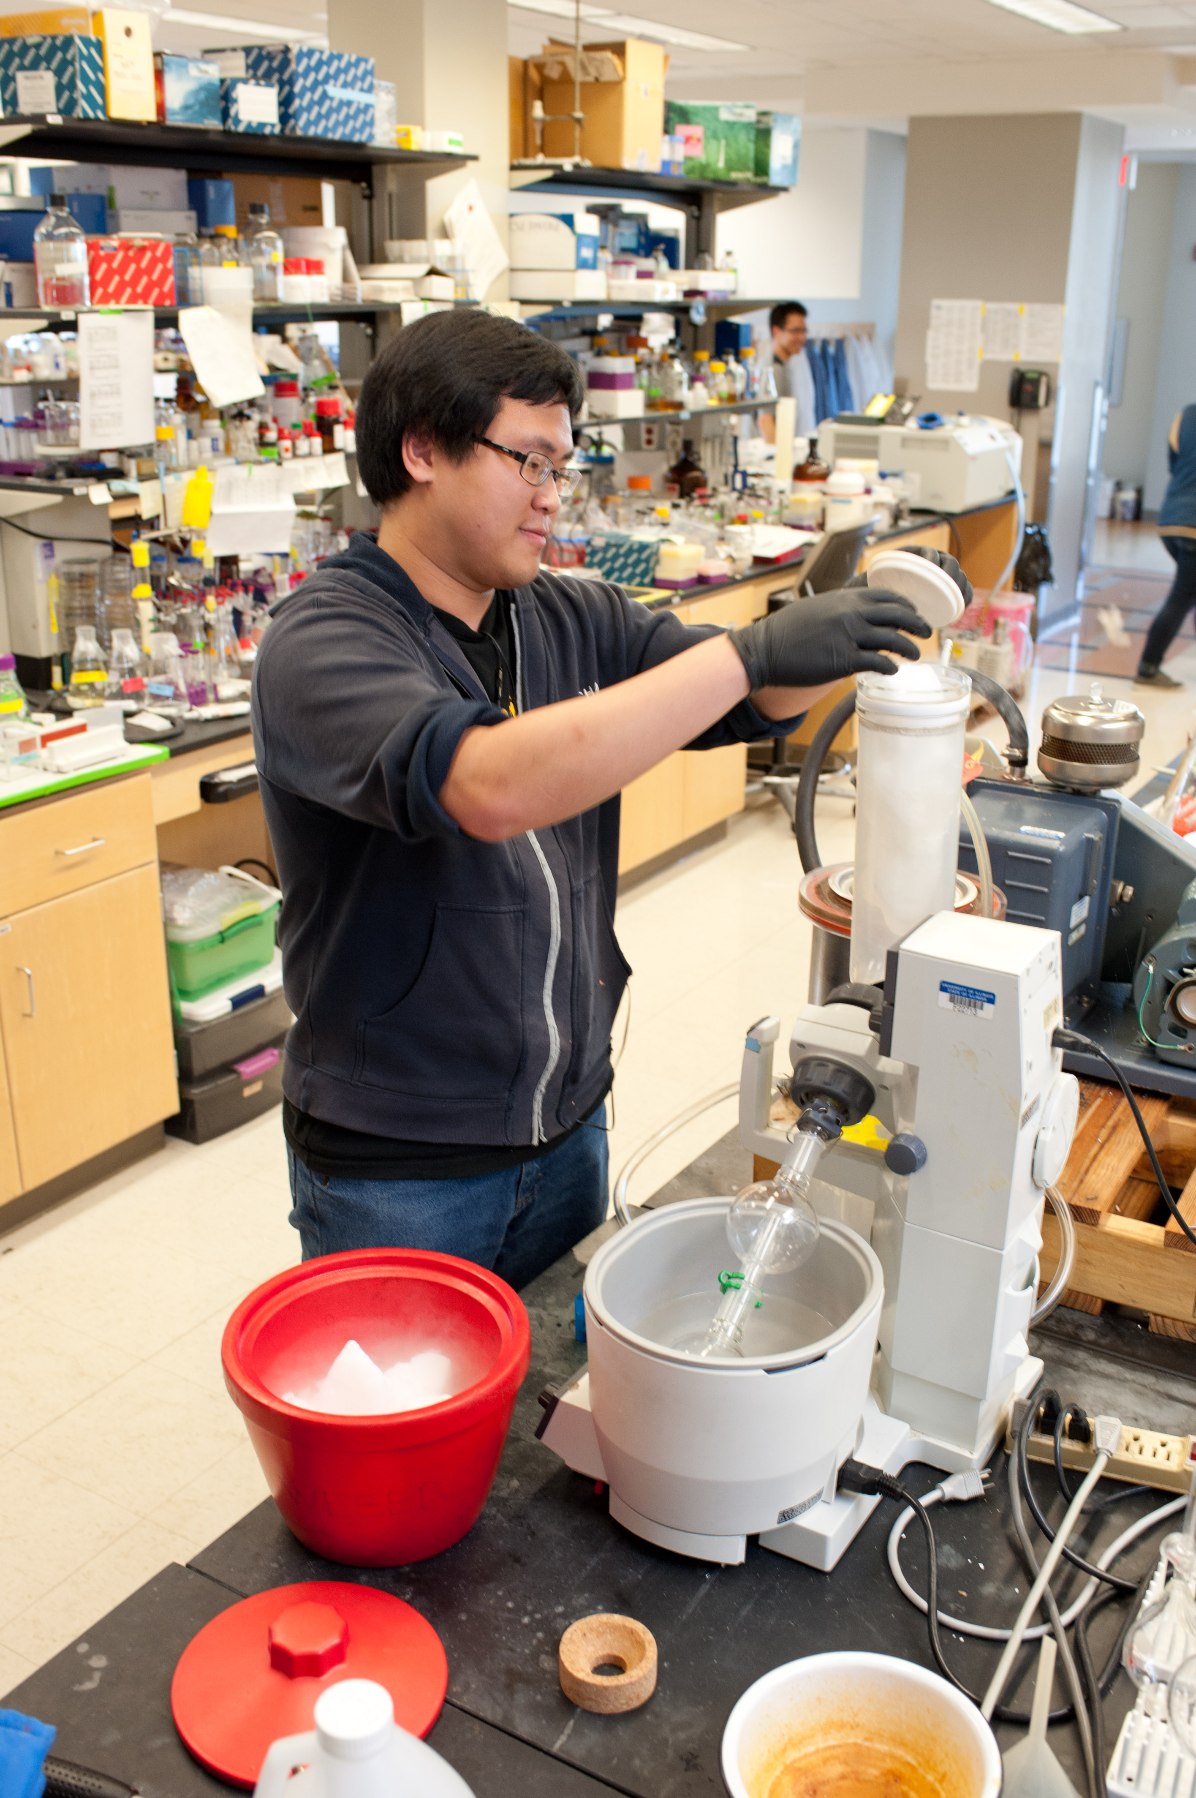
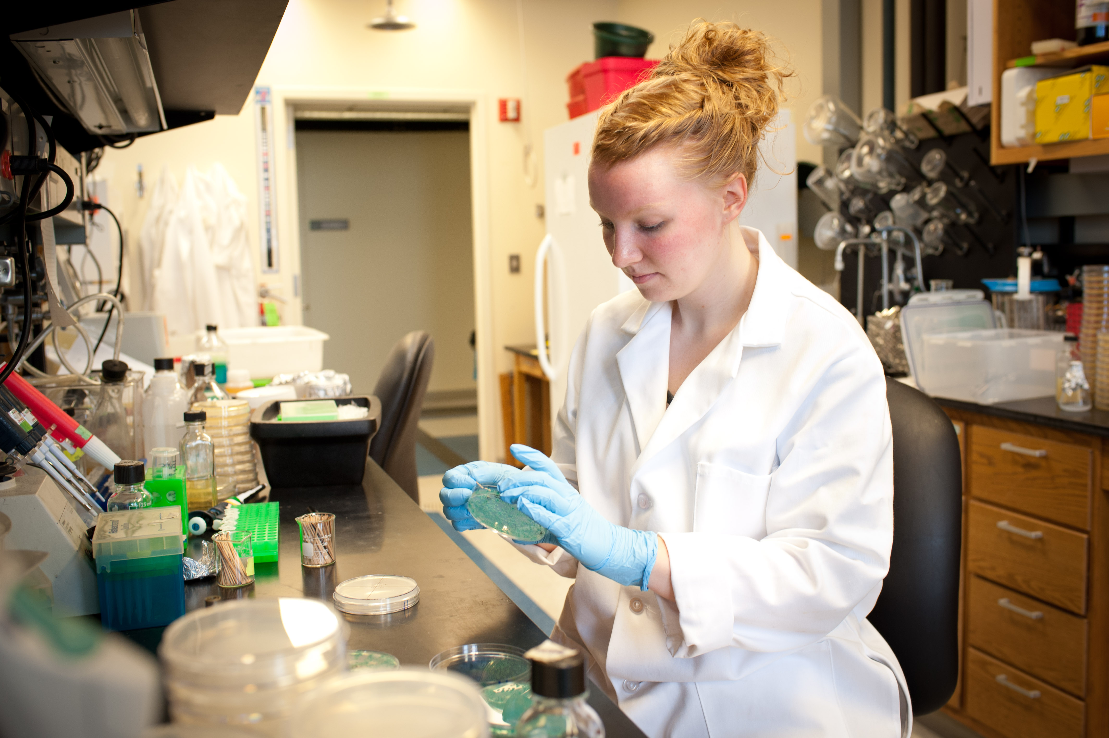
What Is Undergraduate Research?
A mentored investigation conducted by undergraduates that seeks to make a scholarly contribution to knowledge.
Original work performed under the direction of a UIUC faculty member (P.I.), post-doc or graduate student.
Earn course credit (MCB 290 or BIOC 290)
Earn a grade for their contributions to the lab
Some paid positions exist (Campus Job Board)
Cannot earn money if earning credit

Slide 5
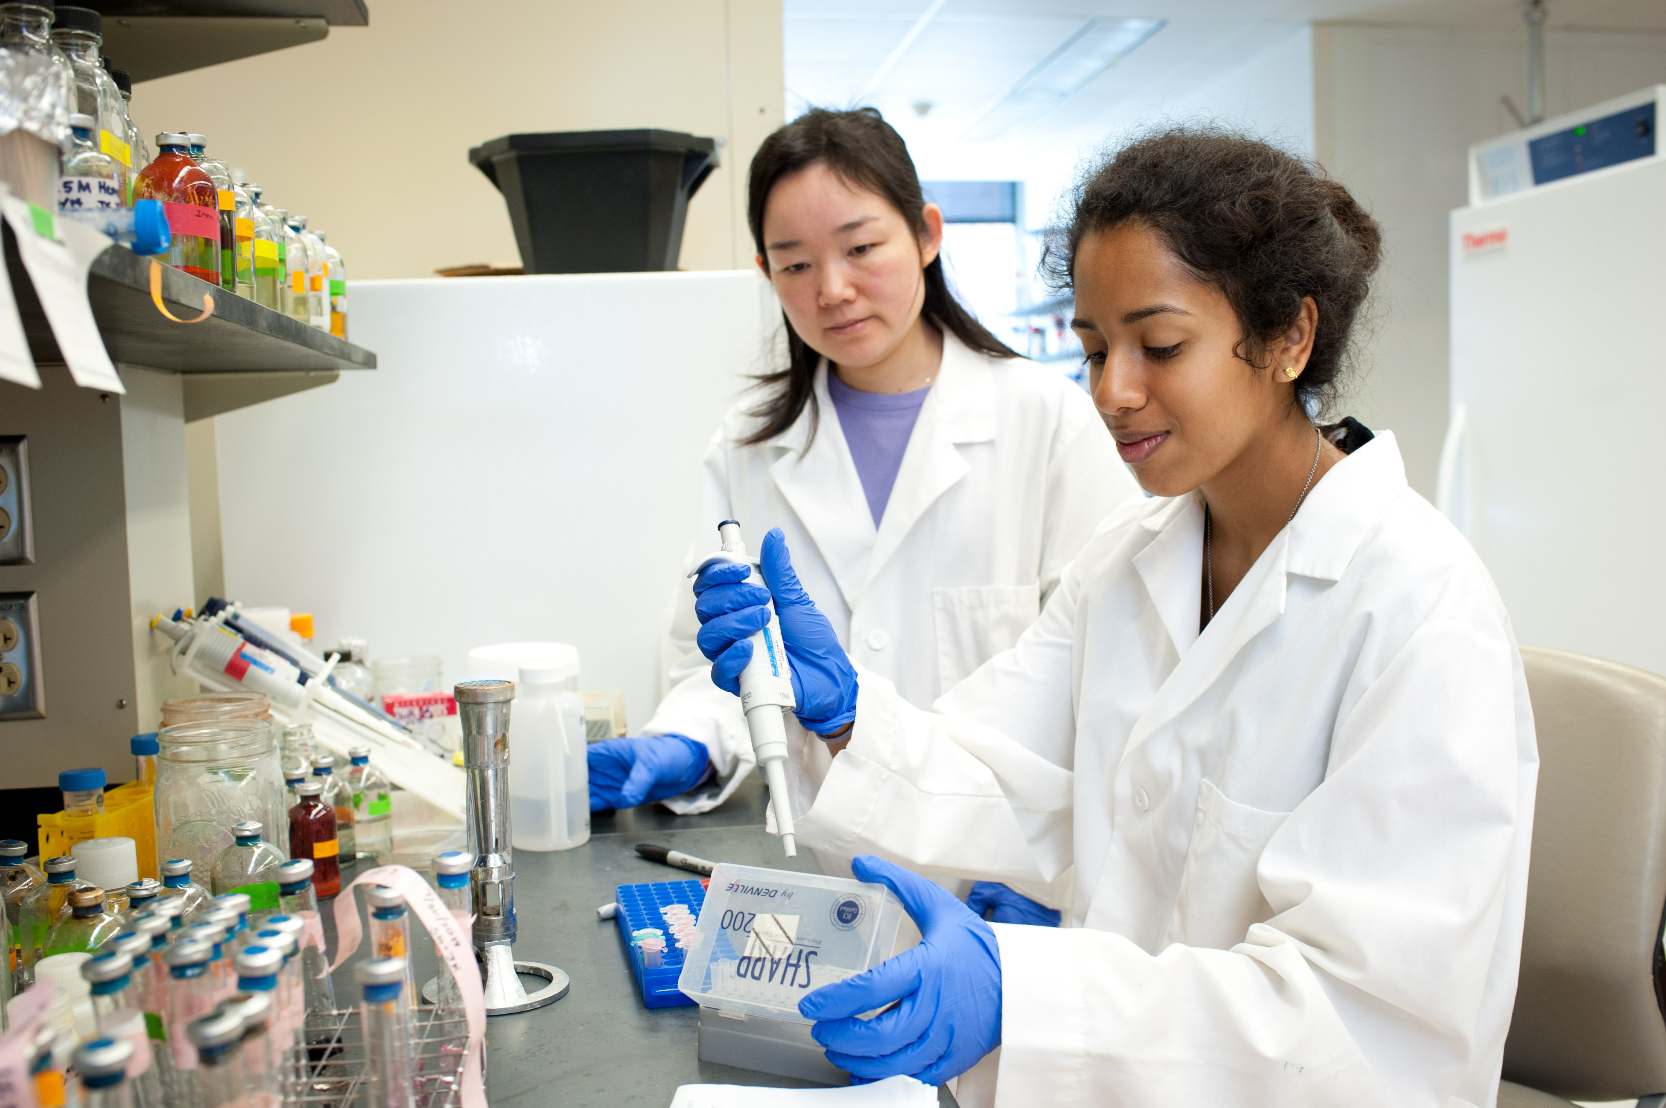
Why Research?
Enrich your educational experience
Make connections with faculty
Develop skills in analytical thinking, communication and teamwork
Determine if graduate studies may be a viable post-graduate goal

Slide 6
Why Research?
Gain intensive practical knowledge using modern technology
Explore issues and methods in your field of interest
Build confidence
Practice problem solving

Slide 7
Eligibility for MCB 290/BIOC 290
Must be a declared major in Biology, MCB, MCB Honors, Neuroscience, or Biochemistry
Conduct research in an approved laboratory at UIUC
Good academic standing, recommended GPA of 2.75 or higher
Cannot receive monetary payment, or any other form of academic credit, based on the research for which MCB 290 or BIOC 290 credit is earned.
Must enroll in the course by the university deadline to add a semester course using the appropriate forms.
http://mcb.illinois.edu/undergrad/opportunities/research/

Slide 8
Typical Workload
1 credit MCB/BIOC 290 = approximately 5 hrs/week in lab/over a 16-week term (8-week summer sessions, 1 credit = 10 hrs/week)
Keep in mind this is an average. You need to plan to stay until your work is done. Each lab will have own policies.
Make sure you have a clear understanding of the faculty expectations for credit and how your grade will be assessed.

Slide 9
Expectations
Show dedication to the project. This should be a priority.
Read primary research articles
May need to come in at odd hours, including nights and weekends.
May be expected to attend lab meetings.
May be expected to present your data.
May be expected to write a senior thesis.

Slide 10
Limits ?
A limit of 10 credit hours of MCB 290/BIOC 290 can be applied towards the 120 hours needed for graduation
However, you are encouraged to continue your research for as many terms as you wish.
All MCB 290/BIOC 290 semesters and the assigned letter grades will appear on your transcript and count in your GPA.

Slide 11
How to Find a Lab
Determine when you want to start and how long you can commit; then plan your course/work schedule accordingly.
Review information on SMCB websites, talk with TAs and faculty in your classes
Read about faculty and their research interests
Make a list of faculty with whom you want to work
Create an online student profile (bioc students use Jeff’s email template)
Contact faculty via email: Be professional and concise; follow up, if necessary

Slide 12
How to Find a Lab
Review information on MCB websites
mcb.Illinois.edu/undergrad/opportunities/research/

Slide 13
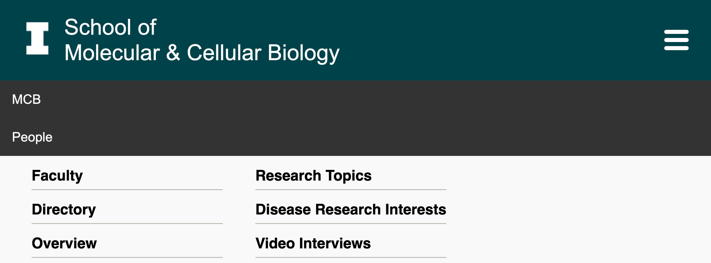
How to Find a Lab
Read about faculty research interests
mcb.Illinois.edu, click on “people”
Google UIUC ______ research or _______ faculty
Make a list of faculty you want to contact

Slide 14
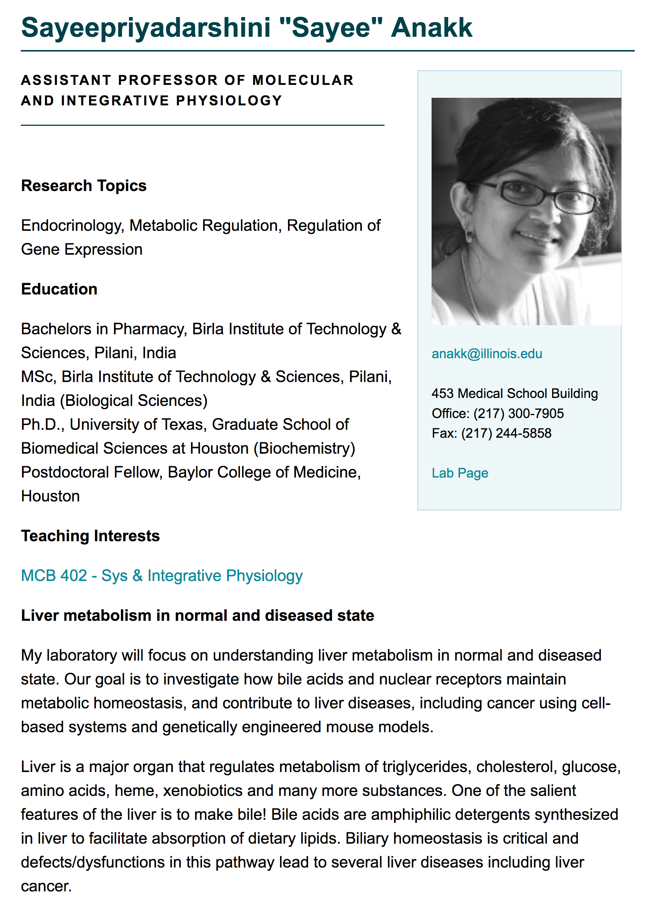
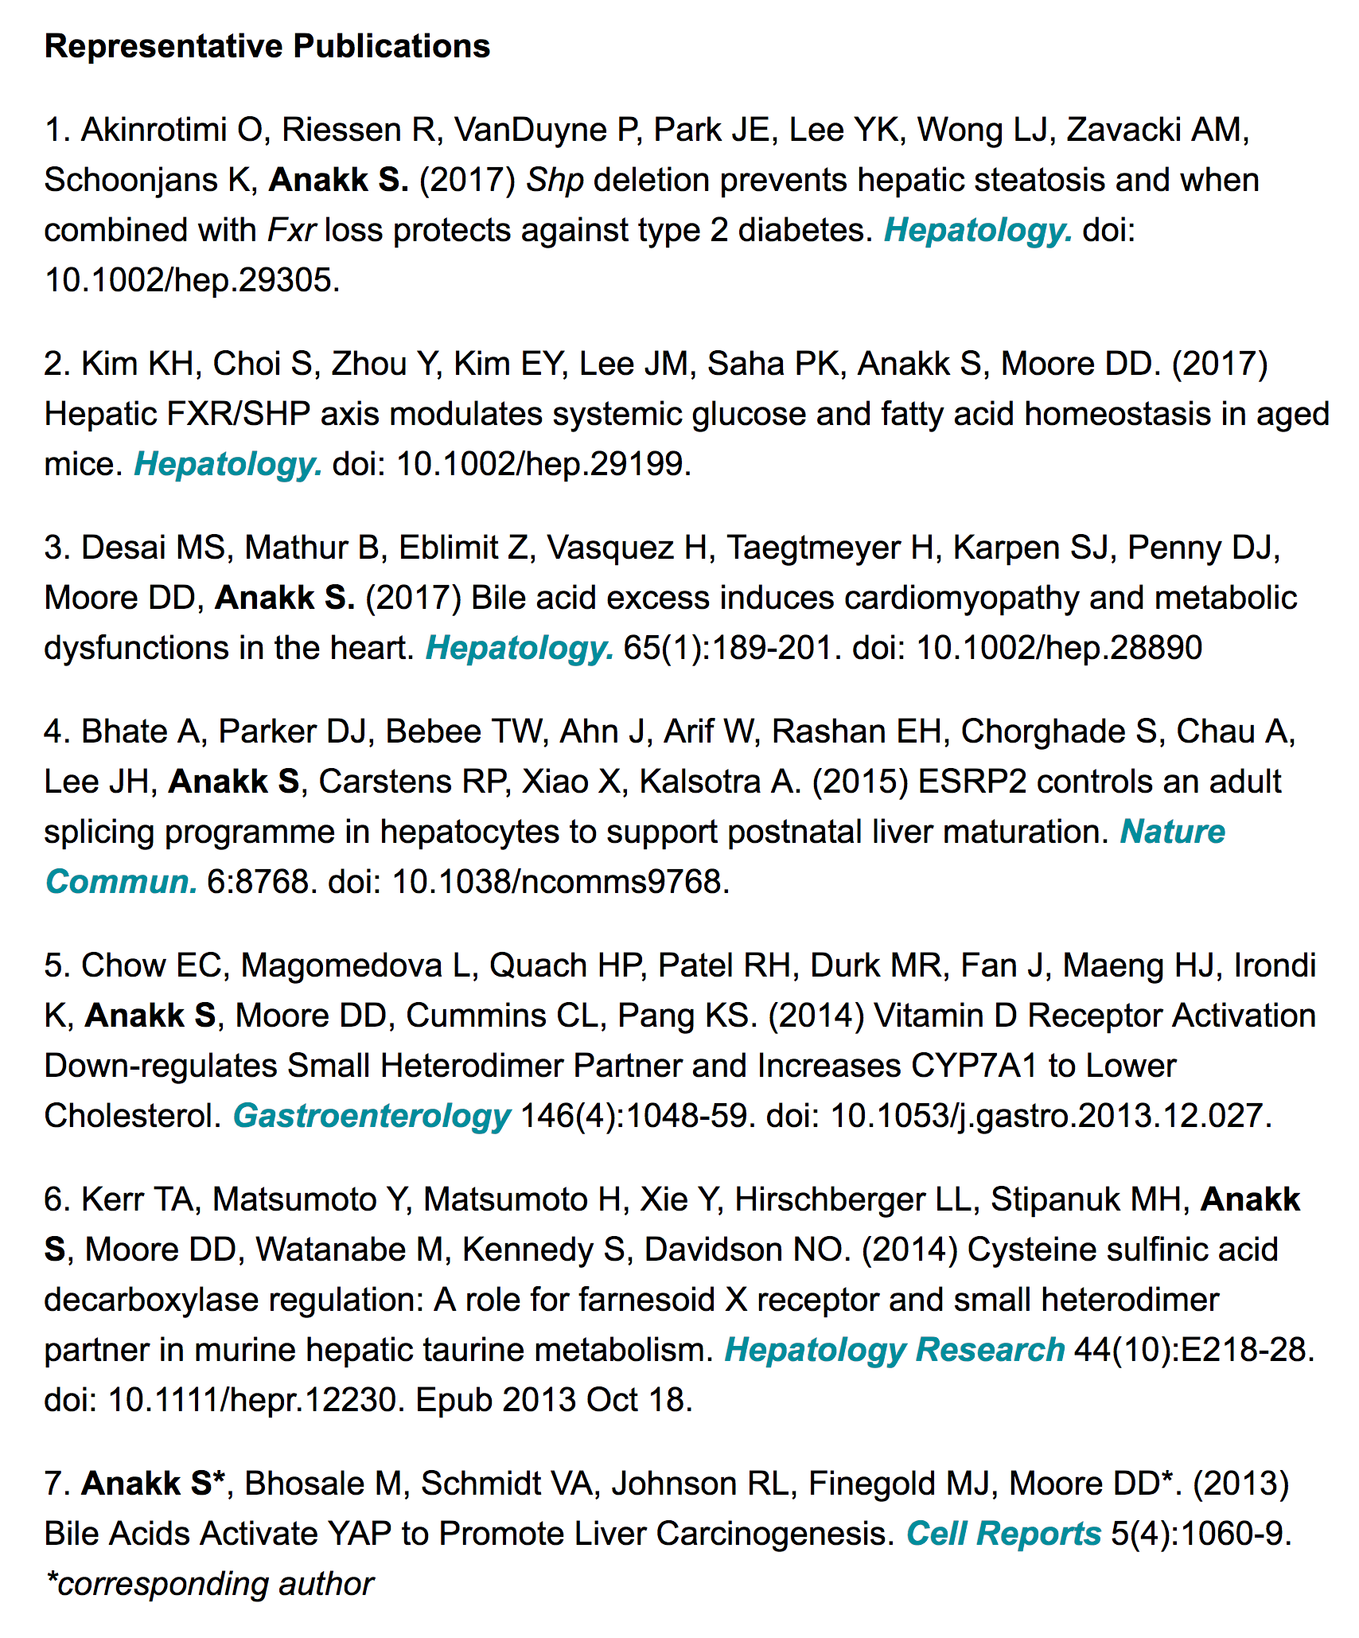
Faculty
Profile

Slide 15
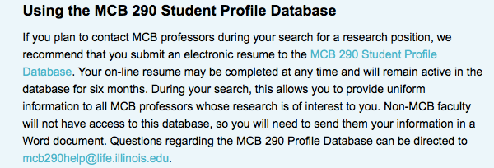
How to Find a Lab
Create an online Student Profile

Slide 16
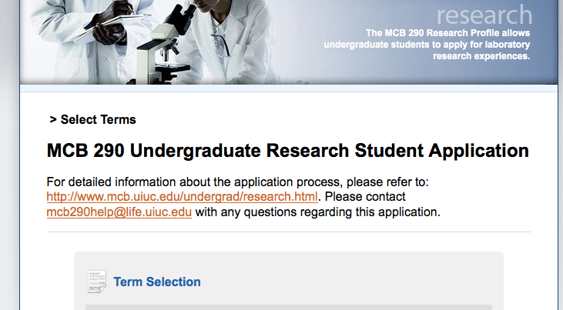
Student Profile Database

Slide 17
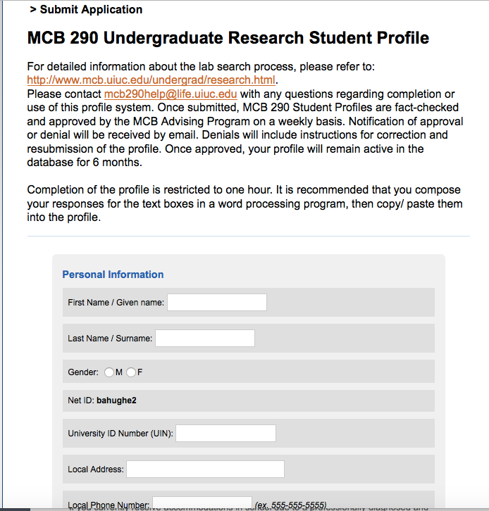
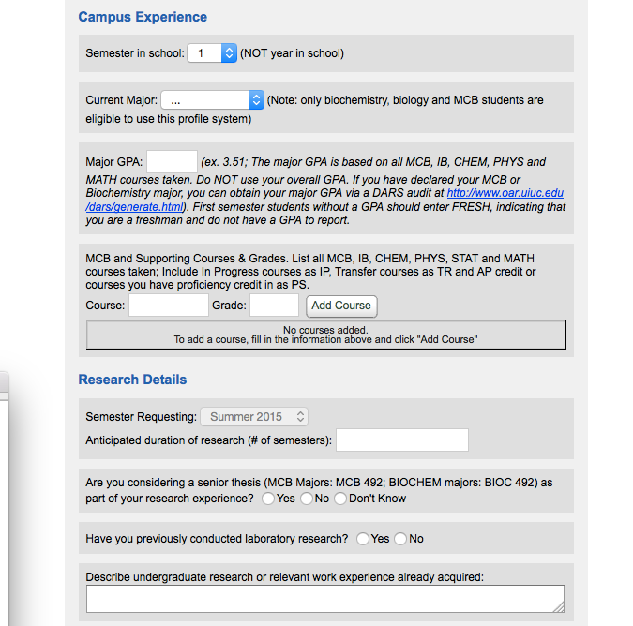

Slide 18
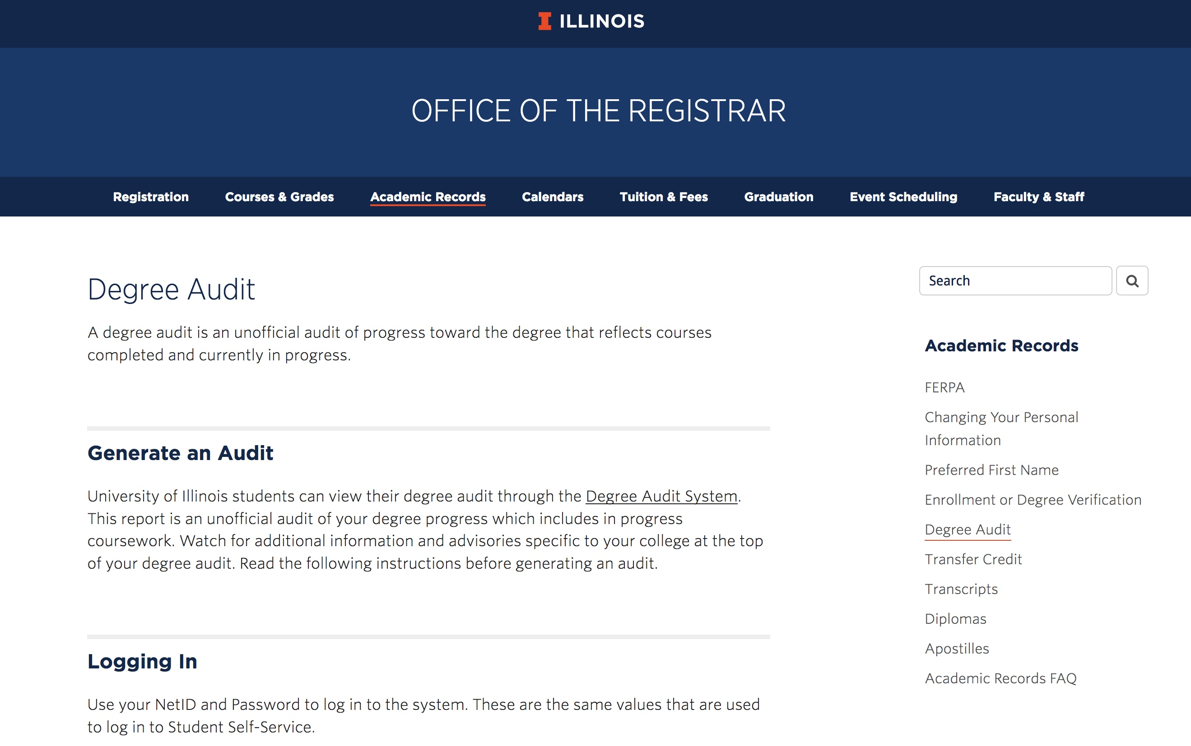
Finding your Major GPA
Run a Degree Audit for your major
Scroll down to find “Major GPA Requirement”

Slide 19
Student Profile Database
Profile information is checked for accuracy by MCB Advising, typically takes ~1 week for processing.
Upon approval, you will receive an email with a link to your profile that you can send to MCB faculty.
Profile is only active for 6 months, then must update
Only available to MCB/BIOC students
Only viewable by MCB/BIOC faculty

Slide 20
How to Find a Lab
Contact Faculty
Send introductory email – preferred method
Be professional (use greeting and signature)
Be specific to each lab – why are you interested in their research?
Be patient and persistent
May have to send a follow up email
Wait at least 5 days between emails
Work in batches, contact 5 or 6 labs at a time

Slide 21
How to Find a Lab
Template for Introductory email
Dear Dr. Anakk,
My name is Tina Knox. I’m a sophomore in MCB and am very interested in undergraduate research as I’m considering graduate school in the future. In looking at your research website, I see that you study liver metabolism. I’ve learned a bit about metabolic pathways in my MCB classes and would love to get a deeper understanding of how they relate to disease in the body. Do you have space for an undergraduate in your lab next spring?
I’ve linked to my student profile here, studentprofilelink. If you need any additional information, let me know. I hope to hear from you soon about opportunities in your lab.
Thanks for your consideration,
Tina Knox

Slide 22
Interview Tips
Casual dress, but professional
Come prepared to talk generally about lab projects and why you are interested
Ask about expectations!!!!
When/how often are you expected to be in lab?
How will your grade be determined?
Be honest about your availability
Academics should come first?
Send a brief thank you email

Slide 23
How to Enroll in MCB 290
Fill out online form before add deadline.
https://mcb.illinois.edu/undergrad/opportunities/research/#forms
Note if this is an official MCB lab or Non-MCB lab
Note if this is a first request or renewal
Need netid of PI – not grad student or post-doc
For Non-MCB labs, attach 1 page research proposal

Slide 24
How to Enroll in MCB 290
You will receive a notification email confirming the form has been submitted.
Automatically sent to PI for approval.
After PI approves, automatically sent to MCB for approval.
Once approved, you will receive email from MCB290@mcb.Illinois.edu with the CRN to register.
You must register for the class on your own before the deadline! Will default to one credit hour.

Slide 25
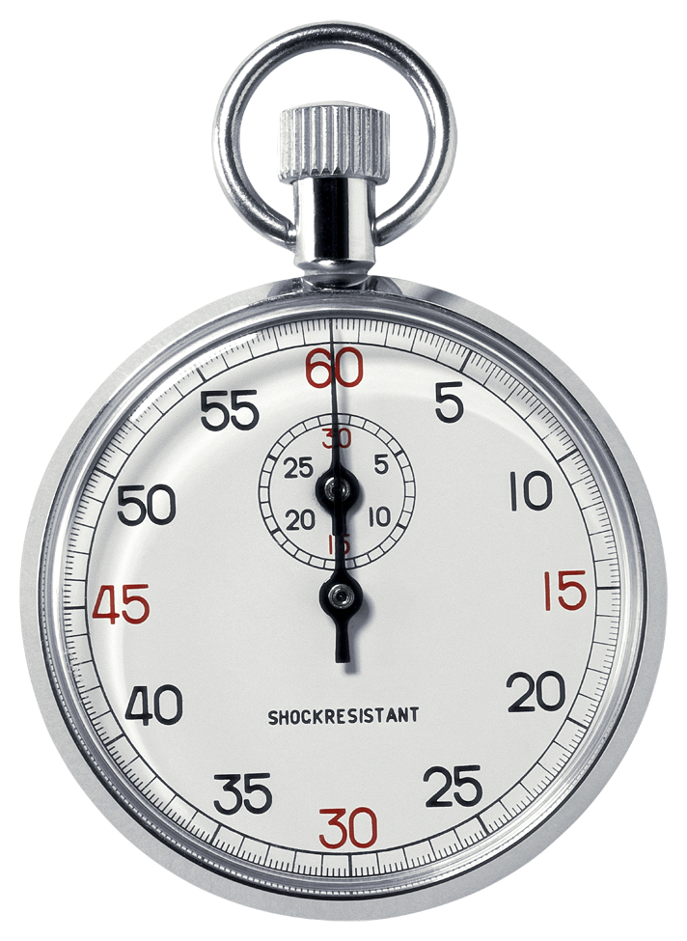
MCB 290 Deadlines
10th day of fall/spring semester at 5:00 PM
7th day of summer session II at 5:00 PM
Must renew every semester by the deadline using online form.

Slide 26
Non-MCB Labs to Consider
Integrative Biology | Chemistry
Psychology Neuroscience program | Kinesiology
Bioengineering Physics | Veterinary Medicine Pathobiology Comparative Biosciences
Crop Sciences | Animal Sciences
Beckman Institute | Institute for Genomic Biology (IGB)

Slide 27
Safety
Before beginning research, your PI should ask you to complete safety training specific to your lab.
Wear appropriate Personal Protective Equipment (PPE) or other protective equipment as required by your lab or other research setting.
Take online lab safety training through the Division of Research Safety. https://www.drs.illinois.edu/.

Slide 28
Know Your Rights
“It is the policy of the University not to engage in discrimination or harassment against any person….”
If you feel your rights have been violated, please consult the Office of the Dean of Students or reach out to your Academic Advisor for help finding resources.

Slide 29
Faculty Perspective
Dr. William Brieher
Professor of Cell and Developmental Biology
Research Interests
Cell organization
Actin Cytoskeleton
Understanding cell shape, motility, and morphology
Molecular basis of inherited kidney disease

Slide 30
Student Perspectives
Faisal Zaidi, Senior 4th semester + SURF, microbiology faisalz2@Illinois.edu | Will Reiser, Senior 5th semester + SURF, microbiology wkr2@Illinois.edu
Maya Raviv, junior 3rd semester, cell biology mraviv2@Illinois.edu | Eddie Andrews, junior 3rd semester, microbiology edwarda3@Illinois.edu
Zainab (Zee) Umardeen, senior 1st semester, comparative biosciences zumard2@Illinois.edu | Joey O’Brien, junior 2nd semester, Entomology/plant pathology jto4@Illinois.edu

Slide 31
Graduation with Distinction
Eligibility for MCB 492 and/or distinction:
Spend a minimum of 2 semesters in the same lab before final semester
Earn a minimum of 2 credit hours MCB 290 each semester in that same lab
Have support of faculty – they will have to write a letter of support
Give oral presentation within the academic year prior to graduation
For high/highest distinction consideration, register for MCB 492 in final semester of degree program and write a senior thesis
For distinction consideration, register for MCB 290 in final semester of degree program
http://mcb.illinois.edu/undergrad/opportunities/distinction/

Slide 32
Take Home Points
Earn course credit and a grade for research experience
Start early – Be aware of deadlines
Understand faculty expectations
Be professional and responsible
Have fun and learn as much as you can

Slide 33
Questions
Tina Knox
tmknox@Illinois.edu
mcb.Illinois.edu/undergrad/opportunities/research/

